Slide 1
CONCEPT OF HEALTH AND ILLNESS
Presented by-
Mr. Prashant Sharma
Assistant Professor
TMCON, TMU

Slide 2
CONCEPT OF HEALTH
Health is evolved over the centuries as a concept from individual concern to world wide social goal and encompasses the whole quality of life. Changing concept of health till now are:
Biomedical concept
Ecological concept
Psychosocial concept
Holistic concept

Slide 3
BIOMEDICAL CONCEPT
Traditionally, health has been viewed as an “absence of disease”, and if one was free from disease, then the person was considered healthy.
This concept has the basis in the “germ theory of disease”.
The medical profession viewed the human body as a machine, disease as a consequence of the breakdown of the machine and one of the medical team’s task as repair of the machine.

Slide 4
ECOLOGICAL CONCEPT
From an ecological point of view; health is viewed as a dynamic equilibrium between human beings and the environment, and disease is the maladjustment of the human organism to the environment.
According to Dubos “Health implies the relative absence of pain and discomfort and a continuous adaptation and adjustment to the environment to ensure optimal function.”
The ecological concept raises two issues, imperfect man and imperfect environment.

Slide 5
PSYCHOSOCIAL CONCEPT
According to the psychosocial concept “health is not only biomedical phenomenon but is influenced by social, psychological, cultural, economic and political factors of the people concerned.”

Slide 6
HOLISTIC CONCEPT
This concept is the synthesis of all the above concepts.
It recognizes the strength of social, economic, political and environmental influences on health.
It described health as a unified or multidimensional process involving the well-being of the whole person in the context of his environment.

Slide 7
DEFINITION
HEALTH
“Health is a state of complete physical , mental , and social well-being and not merely the absence of disease or infirmity”
-WHO

Slide 8
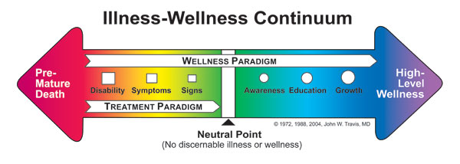
CONCEPT OF WELLNESS

Slide 9
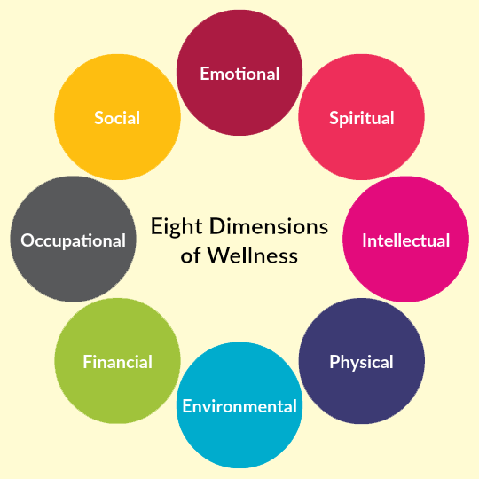
Health Dimensions

Slide 10
Physical dimension
Physical dimension views heath from a physiological perspective.
It conceptualizes health as biologically a state in which each and every organ even a cell is functioning at its optimum capacity and in perfect harmony with the rest of the body.
Physical health can be assessed at the community level by the measurement of morbidity and mortality rates.

Slide 11
Mental dimension
Ability to think clearly and coherently. This deals with sound socialization in communities.
Mental health is a state of balance between the individual and the surrounding world, a state of harmony between oneself and others, coexistence between the relatives of the self and that of other people and that of the environment.
Mental health is not merely an absence of mental illness.

Slide 12
SOCIAL DIMENSION
It refers to the ability to make and maintain relationships with other people or communities.
It states harmony and integration within and between each individual and other members of the society.
social functioning and the ability to see oneself as a member of a larger society.

Slide 13
Spiritual dimension
Spiritual health is connected with religious beliefs and practices. It also deals with personal
Creeds, principles of behaviour and ways of achieving peace of mind and being at peace with oneself.
It is intangible “something” that transcends physiology and psychology.
It includes integrity, principle and ethics, the purpose of life, commitment to some higher being, and belief in the concepts that are not subject to “state of art” explanation.

Slide 14
CONCEPT OF DISEASE AND ILLNESS
Ecological point of view disease is defined as “a maladjustment of the human organism to the environment.”
The simplest definition is that disease is just the opposite of health: i.e. any deviation from normal functioning or state of complete physical or mental well-being.

Slide 15
Illness refers to the presence of a specific disease, and also to the individual’s perceptions and behaviour in response to the disease, as well as the impact of that disease on the psychosocial environment.
Sickness refers to a state of social dysfunction.

Slide 16
THEORIES OF DISEASES CAUSATION
Supernatural theory of disease
Disease is due to superpower e.g. gods, evil spirits.
Tridosha theory of disease
The doshas or humor are Vaata (Wind),
Pitta (gall), and Kapha (mucus).
Perfect balance of tridosha is healthy
Disturbance in balance is a disease

Slide 17
Theory of Contagion
Spreading of disease by being close to or touching other people.
Miasmatic theory of disease causation
Disease is due to noxious air and vapours
These concepts were prevailing before Louis Pasteur (1822-1895).

Slide 18
Germ Theory of disease
In 1860, Louis Pasteur demonstrated the presence of bacteria in the air.
This theory emphasized that the sole cause of the disease is microbes.
The theory is generally referred to as the one-to-one relationship between disease agent and disease.
Disease agent Man Agent

Slide 19
Epidemiological Triad concept
The germ theory of disease has many limitations.
For example it is well–known that not all exposed to tuberculosis bacilli develop tuberculosis, the same condition in an undernourished person may result in clinically manifest.

Slide 20
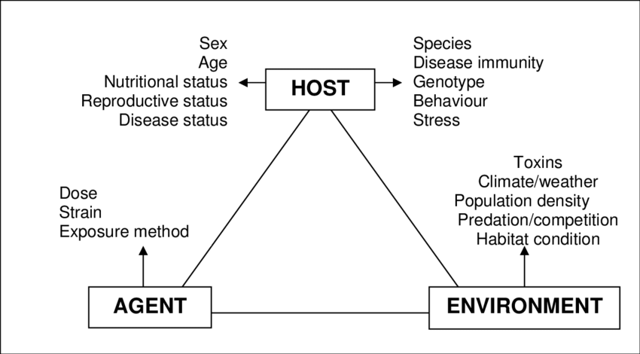

Slide 21
MULTI-FACTORIAL ETIOLOGY
The germ theory of disease or single cause of the disease is always not true.
The germ theory of disease was overshadowed by the multi-factorial cause theory in the 19th century.
As a result of advancements in public health, communicable diseases began to decline and are replaced by new types of diseases so-called modern diseases of civilization.

Slide 22
Example: Lung cancer, CHD, Mental illness etc. The disease could not be explained on the basis of the germ theory of disease and can not be controlled or prevented on that basis. The realization began that multiple factors are responsible for disease causation where there is no clear single agent.
The purpose of knowing multiple factors of disease is to quantify and arrange them in priority sequence for modification to prevent a particular disease.

Slide 23
INTERNATIONAL CLASSIFICATION OF DISEASE
CHAPTER | TITLE
I | Certain infectious and parasitic diseases
II | Neoplasm
III | Diseases of the blood and blood – forming organs and certain disorders involving the immune mechanism
IV | Endocrine, nutritional, and metabolic diseases mental and behavioural disorders
V | Mental and behavioural disorders
VI | Disease of the nervous system
VII | Diseases of the eye and adnexa
VIII | Diseases of the ear and mastoid process
IX | Diseases of the circulatory system

Slide 24
CHAPTER | TITLE
X. | Diseases of the respiratory system
XI. | Diseases of the digestive system
XII. | Diseases of the skin and subcutaneous tissues
XIII. | Diseases of the musculoskeletal system and connective tissues
XIV. | Diseases of the genitourinary system
XV. | Pregnancy, childbirth and pueperium
XVI. | Certain conditions originating in the perinatal period
XVII. | Congenital malformations , deformations, and chromosomal abnormalities
XVIII. | Symptoms , sign, and abnormal clinical and laboratory findings, not elsewhere classified
XIX. | Injury , poisoning , and certain other consequences of external causes
XXI. | Factors influencing health status and contact with health services
XXII. | Codes for special purpose

